Slide 1


KOMMURI PRATAP REDDY INSTITUTE OF TECHNOLOGY
(UGC-Autonomous Institution)
Ghanpur(V), Ghatkesar(M), Medchal(D), Hyderabad-500088
DEPARTMENT OF COMPUTER SCIENCE ENGINEERING(AI&ML)
AGENTIC DEEP RESEARCH SYSTEM
Under the guidance of Presented By
Mr. J. Naresh T. Shruthi (23RA1A66A8)
Assistant Professor M. Sravanthi (23RA1A66B3)
Department of CSE(AIML) T. Srivardhan (23RA1A66B9)
B. Vishnu (23RA1A66D5)

Slide 2
PROBLEM STATEMENT
Traditional search requires users to manually search, open, compare, and summarize multiple sources.
General-purpose AI systems may provide answers without sufficiently transparent source verification.
Information from multiple sources can be difficult to organize into a structured research report.
AI-generated answers may contain unsupported or inaccurate claims.
There is a need for an autonomous research system that can plan, search, retrieve, analyze, verify, and cite information.
The proposed system aims to reduce manual research effort while improving source traceability and reliability.

Slide 3
ABSTRACT
Agentic Deep Researcher is an AI-based multi-step research system.
It accepts a broad research question from the user.
A Planner Agent decomposes the question into smaller research questions.
Searcher and Fetcher Agents collect relevant information from web sources.
A Research Agent analyzes the collected information and generates a structured report.
A Critic Agent is planned to review the report for missing information and unsupported claims.
The system will ultimately support iterative research, source-based citations, and confidence assessment.
The current prototype demonstrates the basic research pipeline using a local LLM and web search.

Slide 4
LITERATURE SURVEY
Yao et al. (2023) – ReAct: Synergizing Reasoning and Acting in Language Models
Combined reasoning and action in language models
Allowed agents to interact with external tools and environments
Improved performance on knowledge-intensive tasks
Demonstrated iterative reason → act → observe behaviour
Limitation: Can still produce errors during reasoning and tool selection

Slide 5
LITERATURE SURVEY
Schick et al. (2023) – Toolformer: Language Models Can Teach Themselves to Use Tools
Focused on enabling language models to use external tools
Used tools such as calculators, search engines, and APIs
Improved the ability of LLMs to obtain information beyond their internal knowledge
Demonstrated the importance of tool-augmented AI systems
Limitation: Tool selection and generated tool calls may still be unreliable

Slide 6
LITERATURE SURVEY
Shinn et al. (2023) – Reflexion: Language Agents with Verbal Reinforcement Learning
Introduced self-reflection for language agents
Agents evaluate previous actions and learn from their mistakes
Used verbal feedback to improve subsequent attempts
Helped agents perform better on tasks requiring multiple attempts
Limitation: Depends on the quality of self-evaluation and may propagate incorrect feedback

Slide 7
LITERATURE SURVEY
Wu et al. (2023) – AutoGen: Enabling Next-Gen LLM Applications via Multi-Agent Conversation
Proposed a framework for multi-agent LLM applications
Multiple agents can communicate and collaborate on tasks
Supports specialized roles and automated task execution
Reduces the need for a single agent to perform every task
Limitation: Multi-agent communication can increase complexity and computational cost

Slide 8
EXISTING SYSTEM
Traditional search engines return a list of webpages.
Users must manually:
  Select relevant sources
  Open webpages
  Read information
  Compare sources
  Extract important points
  Prepare the final report
General AI assistants can summarize information quickly. However, generated answers can contain hallucinated or unsupported information.
Source verification and research coverage may depend heavily on the user.
Existing systems generally do not provide the complete autonomous research cycle.

Slide 9
PROPOSED SYSTEM
Develop an Agentic Deep Researcher using multiple specialized agents.
Planner Agent breaks the main question into sub-questions.
Searcher Agent searches the web for each sub-question.
Fetcher Agent retrieves webpage content.
Research Agent analyzes the collected information.
Critic Agent checks the generated report.
If gaps are detected, the system will perform additional searches.
References will be generated from the actual retrieved source metadata.
Final system will produce a structured, source-grounded research report.

Slide 10
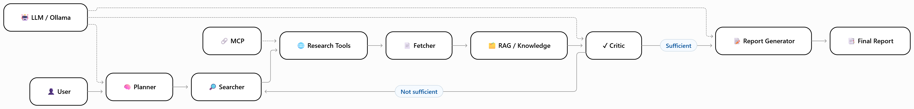
SYSTEM ARCHITECTURE

Slide 11
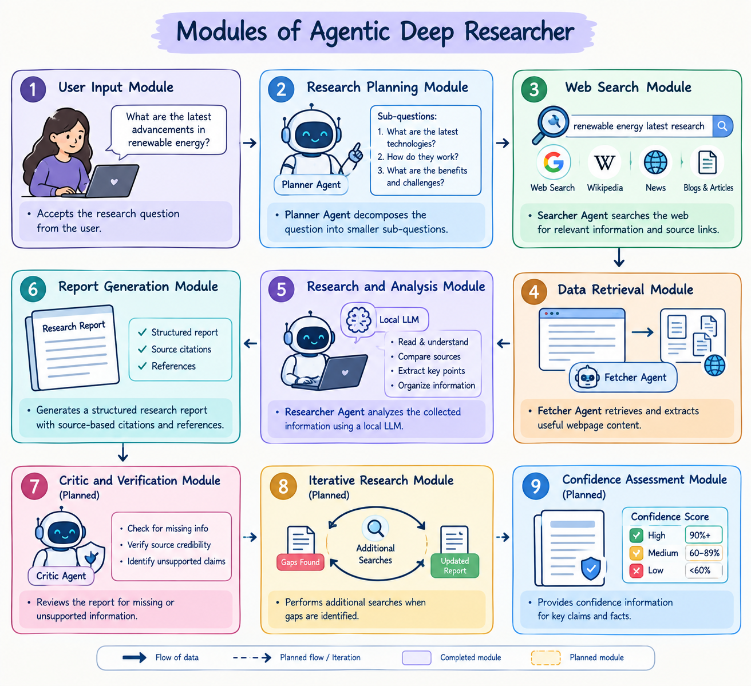
MODULES
User Input Module
Research Planning Module
Web Search Module
Data Retrieval Module
Research and Analysis Module
Report Generation Module
Critic / Verification Module
Final Report with Citations and References

Slide 12
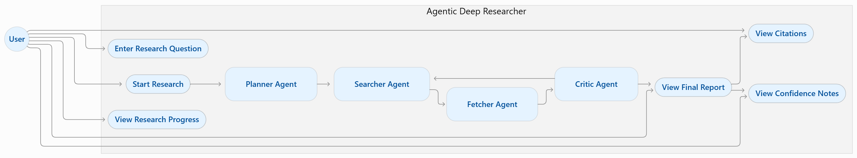
UML DIAGRAMS
Use Case Diagram :

Slide 13
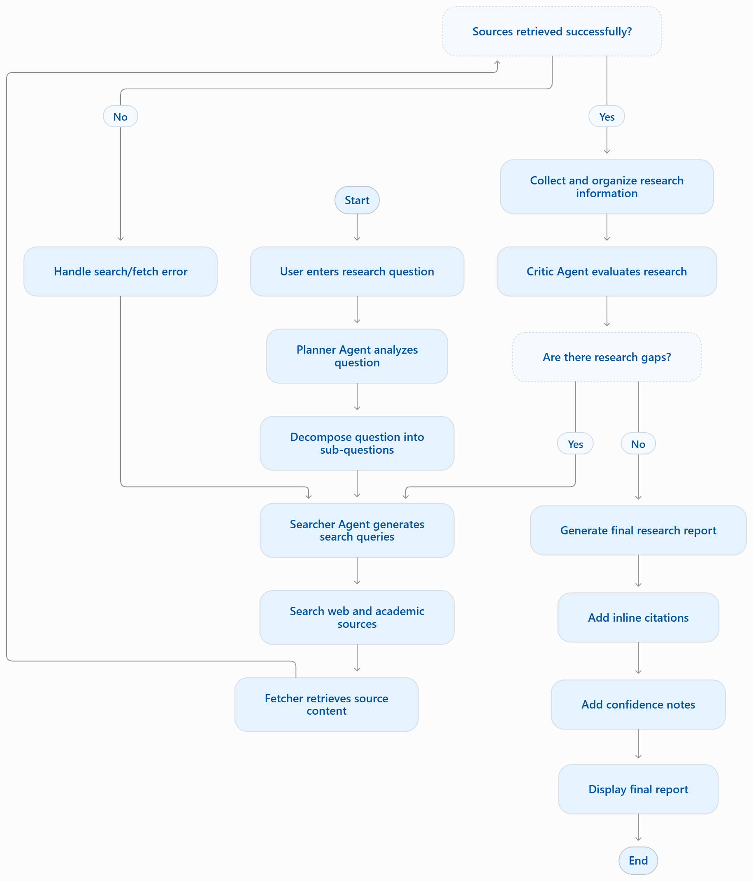
UML DIAGRAMS
Activity Diagram :

